Slide 1
Significance of graves in Intizar Husain's novel ‘Basti'.
STUDENT NAME: TARUNIMA DASGUPTA
ROLL NO. : 1802073 REG. NO.: 1061821400184

Slide 2
Importance of graves in Muslim culture, God created the body, whether death or alive the human body must be respected
In the novel ‘Basti’ we exactly see the same picture

Slide 3
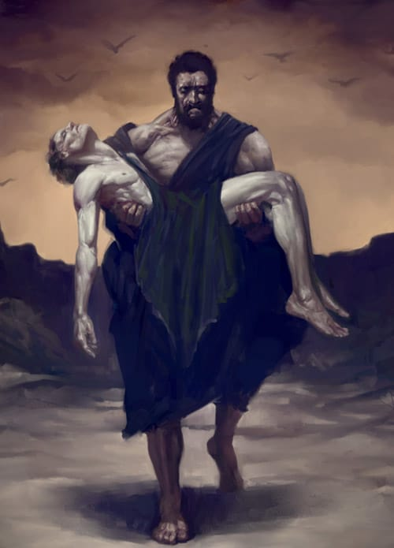
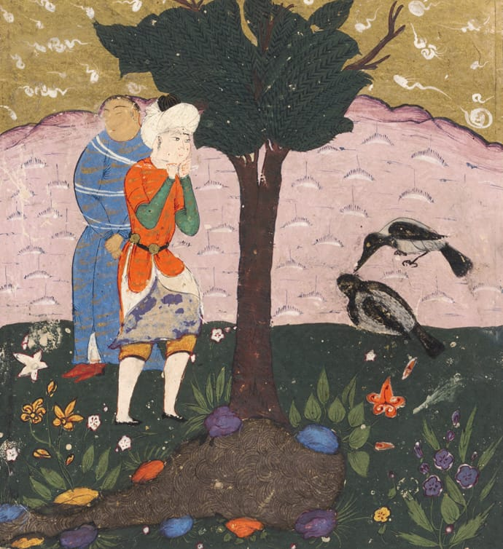
Cain and Abel story from Quran. The first killing of man on earth, The first grave.

Slide 4
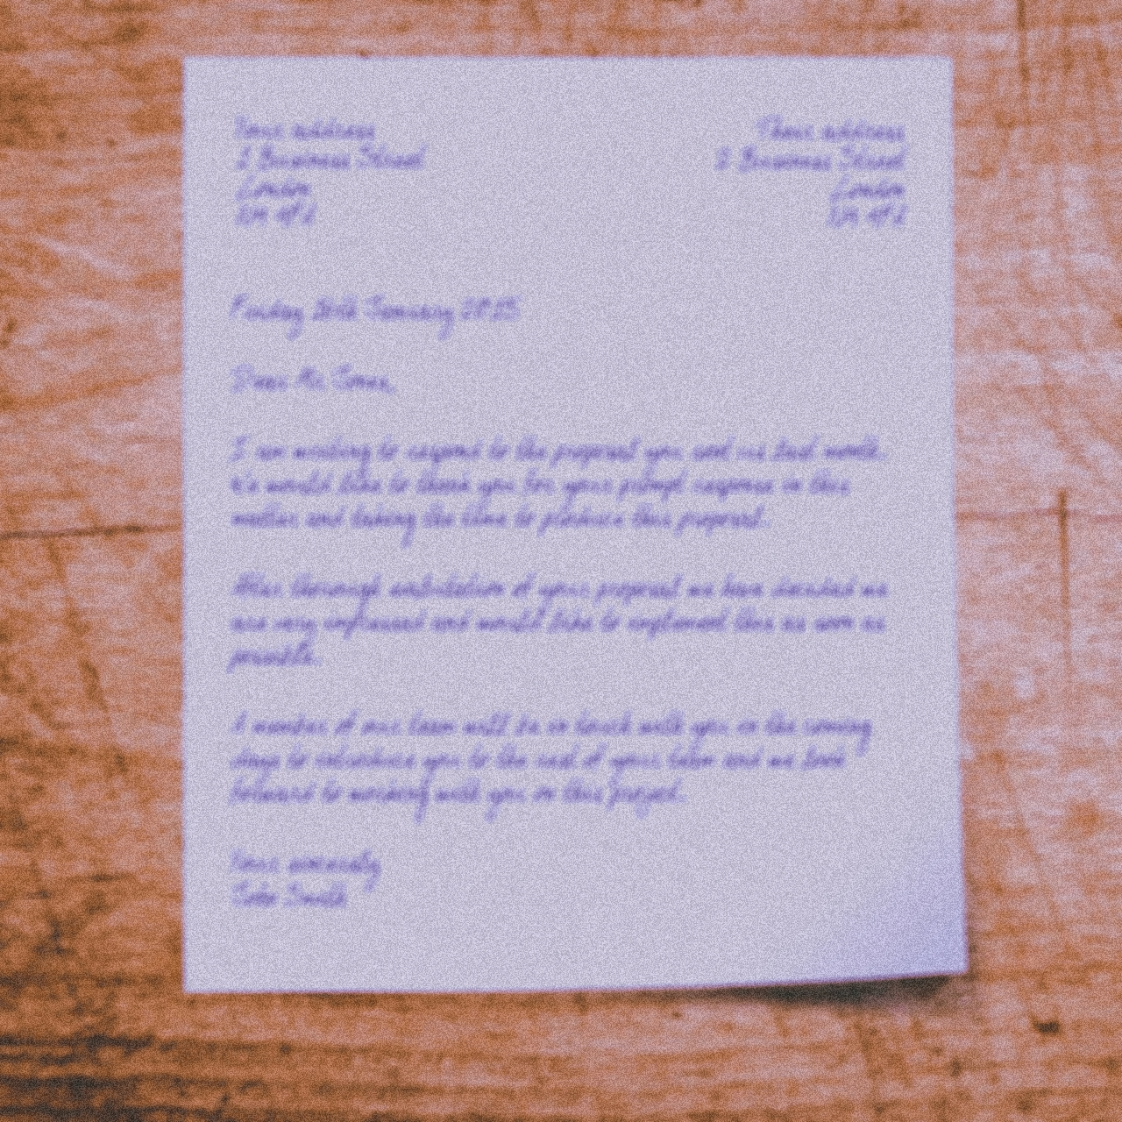
“What great power the graves have in Muslims”

Slide 5
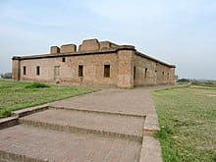
Rupanagar
Rupnagar's graveyard, Zakir's family graves, Bi Ammi was buried there, Zakir's father also wanted to bury there, he had pre- prepared graves for himself, Due to partition they have to left the place, Zakir's father was buried in a new land.

Slide 6
Grave stones are the memorial, people offer flowers, one can pray, inscribe lines, In a way it connects the living to the dead. Zakir and Afzal at the end meet in the middle of the graveyard.

Slide 7
A failed love story of Zakir and Sabirah, In their childhood they made graves for eachother, instead of home.
ZaKir
Sabirah

