Slide 1
BARASAT GOVT COLLEGE
DEPARTMENT OF ENGLISH
NAME OF TOPIC : BASTI AS A PARTITION NOVEL
COURSE NAME: PARTITION LITERATURE
COURSE CODE: ENGADSE05T
SEMESTER: 6th YEAR: 2021
STUDENT NAME: RIMPA GHOSH
ROLL NO. : 1802001
REG NO. :1061821300135

Slide 2
About Partition and Partition novel
Partition - breaking a nation into parts
Partition novels mainly deal with partition and its consequences (pain-trauma-suffering-displacement etc.)
Partition novelists mainly focus on 1947 India-pakistan partition.
Husain differs from them. He talks about two partition in "Basti".
The first partition, based on religion where India and Pakistan are separated.
The second partition, based on language, in which Bangladesh is separated from West Pakistan.

Slide 3
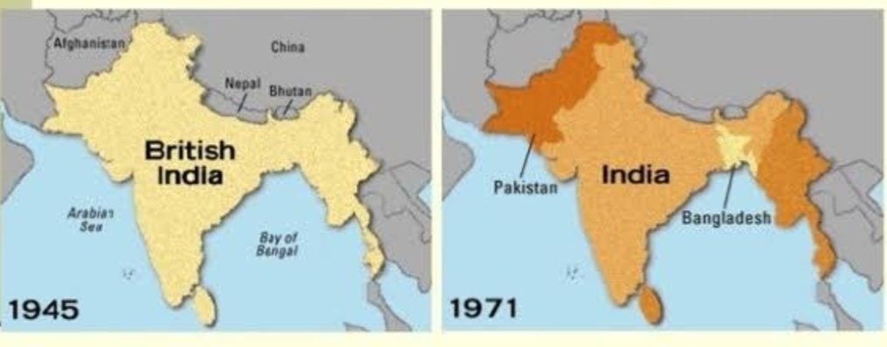
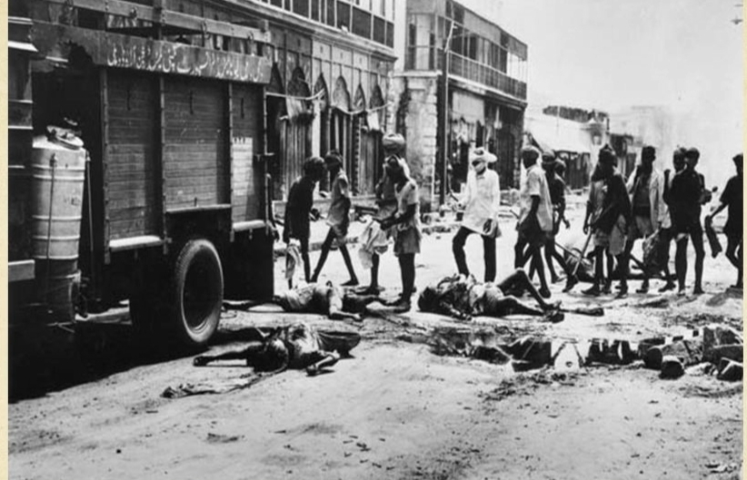
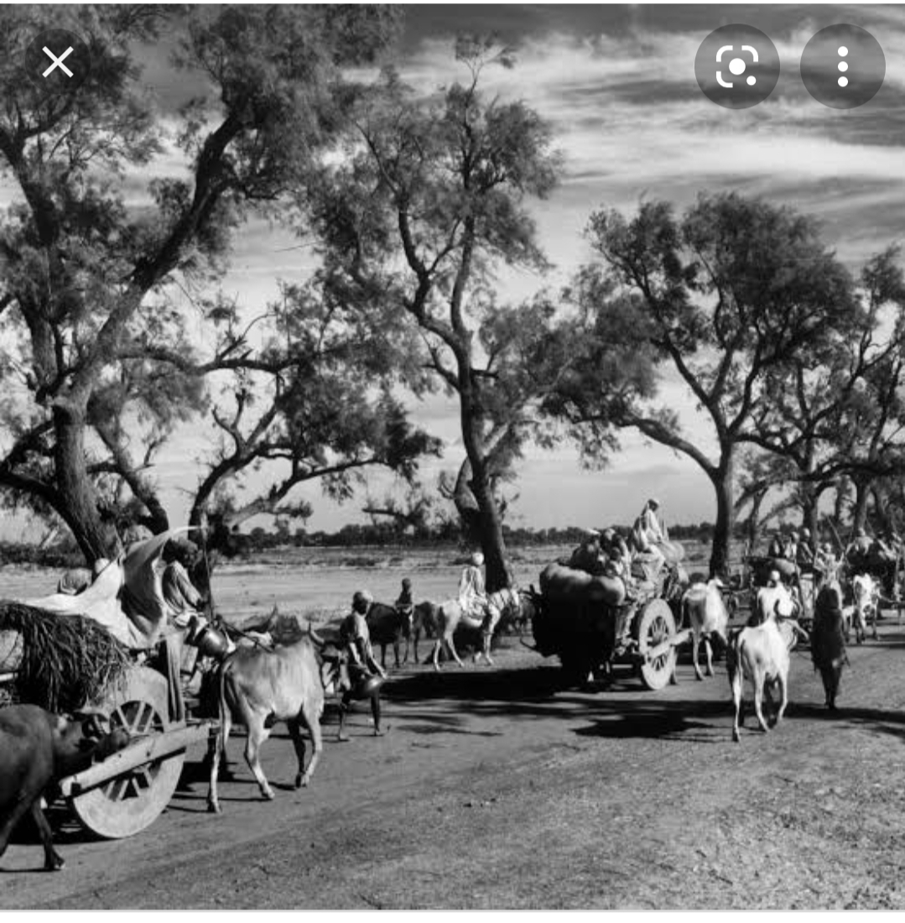
India before and after Partition
Political violence
Largest population movements in History

Slide 4
Effects of the 1947 partition described in "Basti"
Severe blow upon the people who had gone through partition.
Causes detachment from family, childhood place - very familiar.
Collapse of friendship (Zakir-Surendar) and love (Zakir- Sabirah).
Unity of Rupnagar is destroyed.
Causes death and homeless on both side of the partition.
Selfhood and identity are at a loss.

Slide 5
Effects of the 1971 partition in
"Basti":
It questions the relevance of the first partition
It again breaks down the broken selfhood of the people and nation as well.
Missing of trust .People are torn between belief and disbelief.
Political turmoils.
Emergence of divergent discourses
Crumbling of new nation.

Slide 6
Thank you.

