Slide 1
Basti
CHILD’S PERSPECTIVE
NAME: LATA SARKAR
PAPER NAME: PARTITION LITERATURE
ROLL NO. 1802060
REGISTRATION NO.1061821100174

Slide 2
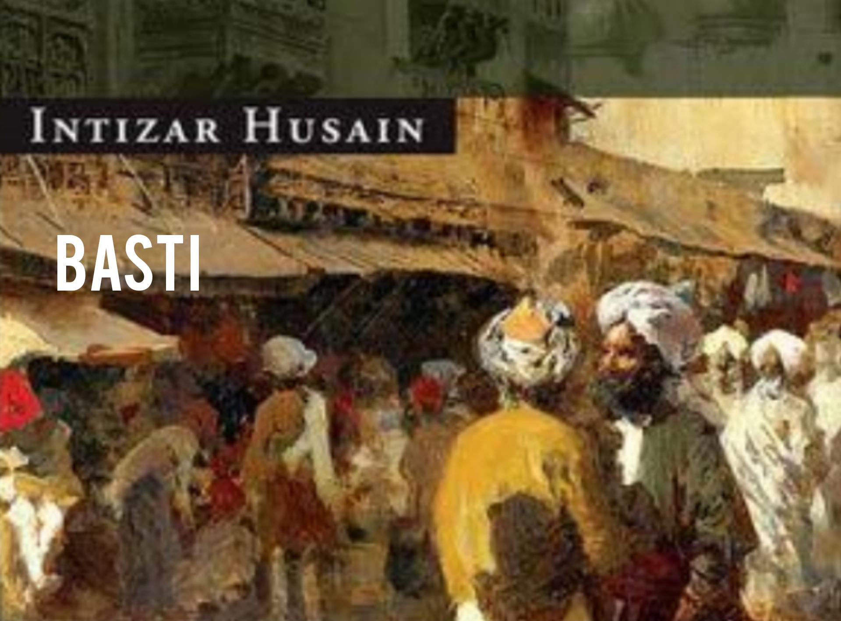

Slide 3
THE CHILD IS ZAKIR
Zakir is the protagonist.
He represents the world of innocence.
Zakir.
He has a lot of questions and tries to find the answers from the explanations of the adults.

Slide 4
ZAKIR’S VIEW ON RELIGION
He was aware of the divisions in the adult world and was respectful towards it.
Despite being a child of a conservative family he has a great deal of faith in Bhagat-ji.
He was different from the other children of his age when it comes to religious view.

Slide 5
COMPARISON BETWEEN THE PERSPECTIVE OF ZAKIR AND SABIRAH
They play grave-digging game.
He wants to play bride and groom game with her. She is both willing and reluctant.
When Zakir mentions the word ‘love’ she blushes and pretends to get angry.

Slide 6
ACKNOWLEDGMENTS
I would like to earnestly acknowledge the sincere efforts and valuable time given by our respected teacher Mrs. Swati Mitra. Her valuable guidance and feedback helped us completing this assignment.

