Slide 1
Exploring memory in Basti
Name – Labani Ghosh
Roll no - 1802007
Registration no. - 1061821300138
Semester - VI
DSE Name - Partition Literature
DSE Code – ENGADSE05T
College – Barasat Government College

Slide 2
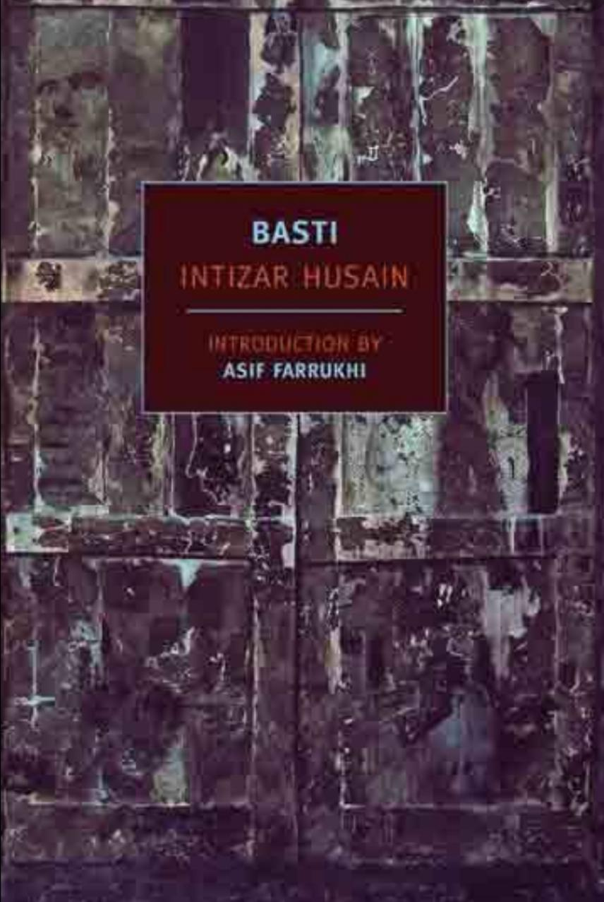
What is memory?
Memory is the faculty by which the mind stores and remembers information.
Memory and the narrative
• The narrative is not linear.
Through Zakir’s memory it traverses back and forth.

Slide 3
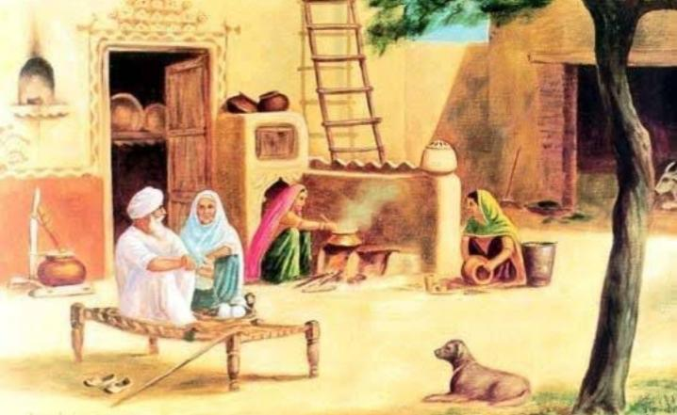
Memory and History
•Zakir’s Abba Jan remembers the time of the Khilafat Movement (1919)- “ Son, have I not seen movements? Has any of them ever been bigger than the Khilafat Movement?”
Memory binds people with the land
Maulvi Matchbox recalls the towns that like empty matchbox “are now empty”.

Slide 4
Memory binds the people who are far from each other
• Zakir recalls – “ Come on, Sabbo, let’s play.”
In Delhi, Sabirah also remembers Zakir and sometimes – “ She said nothing, she burst into tears”.

Slide 5
Conclusion
Memory, the incidents of past in layers,
Zakir, the protagonist, the person who remembers.
Remembrance of Rupnagar, Sabirah,
And of the past time,
Constant back and forth
Narrative like is in a rhyme.
Near the house, the room, the playground,
Near the old friends a bit
So many stories of the past
So many pages of History,
Experiencing once more,
Through the memory kit.
____________

Slide 6
Work Cited
Husain, Intizar. Basti. Translated by Frances W. Pritchett. New Delhi: Oxford University Press, 2007. Web.
Sources of images
https://www.pinterest.com/pin/723953708835986423/
https://images.app.goo.gl/jjwFwvX5xw4M41Ay8
https://images.app.goo.gl/j6YRQu23RjdyRQGcA

